Slide 1



Defect Prediction of LLM generated Java code
Name : Abhishek Kumar Raj Reg. No. : 24MCMC24 Department : MCA, SCIS, University of Hyderabad Supervisor : Dr. Salman Abdul Moiz

Slide 2
Problem Statement
Software defects cause:
Delay in software projects
Extra development cost
Poor software quality
Manual review of large Java codebases is slow
LLM-generated code may contain compile errors, runtime errors, or failed unit tests
Early defect prediction can save development time

Slide 3
Objectives of the Project
The project aims to:
Collect Java sample programs from GitHub and Ollama
Generate JUnit 5 test cases automatically
Analyze Java programs using static metrics
Build CSV datasets with defect labels
Train machine learning models for prediction
Provide prediction through FastAPI web application

Slide 4
Existing System vs Proposed System
Existing System :
Manual code review
Time-consuming testing
Difficult to analyze large codebases
Proposed System :
Automated defect analysis pipeline
Machine learning-based prediction
Automatic test generation
Web-based prediction interface

Slide 5
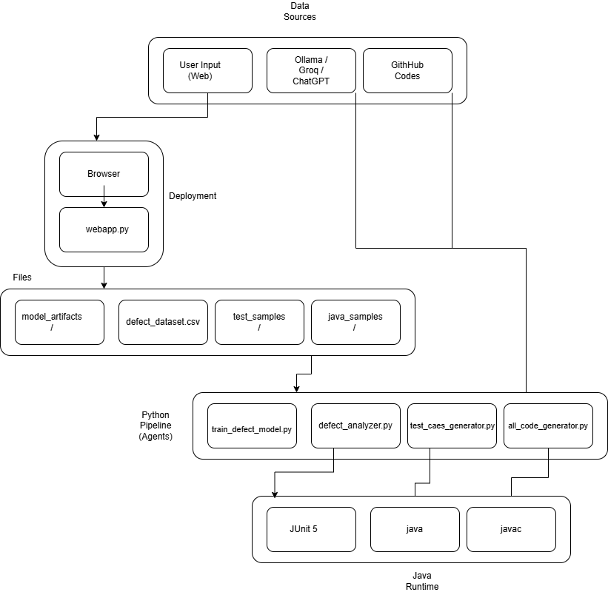
System Architecture
The system works as an end-to-end pipeline :
Java code collection
Test generation
Defect analysis
Dataset creation
ML model training
Web prediction

Slide 6
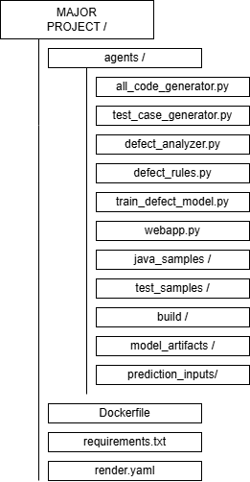
Project Module Structure
The project is divided into modules:
all_code_generator.py → collects Java samples
test_case_generator.py → generates JUnit tests
defect_analyzer.py → compiles and analyzes code
defect_rules.py → applies regex-based defect rules
train_defect_model.py → trains ML models
webapp.py → provides FastAPI web interface

Slide 7
Technologies Used
Technology | Purpose
Python | Backend & ML
FastAPI | Web Framework
Scikit-learn | ML Models
Java & JUnit | Code Testing
Ollama | LLM-based generation
Docker | Deployment
Render | Cloud Hosting

Slide 8
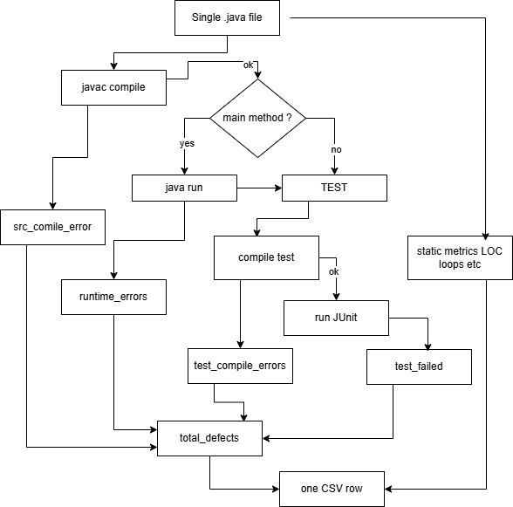
Dataset Generation Process
Java programs are collected from GitHub and Ollama
JUnit 5 test files are generated automatically
Source files are compiled and executed
Static metrics are extracted
CSV datasets are created for ML training
Generated datasets :
defect_dataset.csv
defect_report.csv
train/test split CSV files

Slide 9
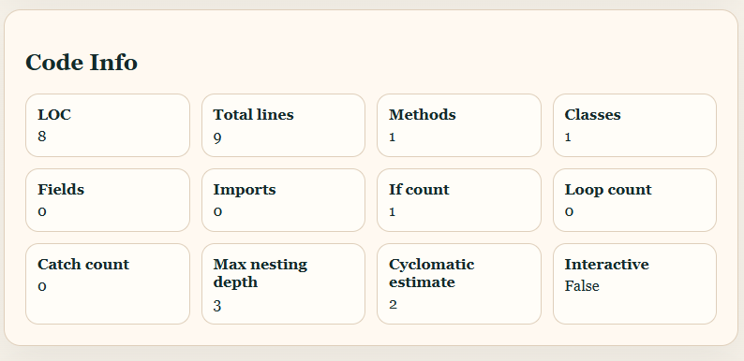
Static Metrics Extracted
The system extracts static metrics such as :
Lines of Code (LOC)
Method count
Cyclomatic complexity
Max nesting depth
Loop count
Catch count
Comment ratio
Additional features :
has_main_method
is_interactive_program
source_origin

Slide 10
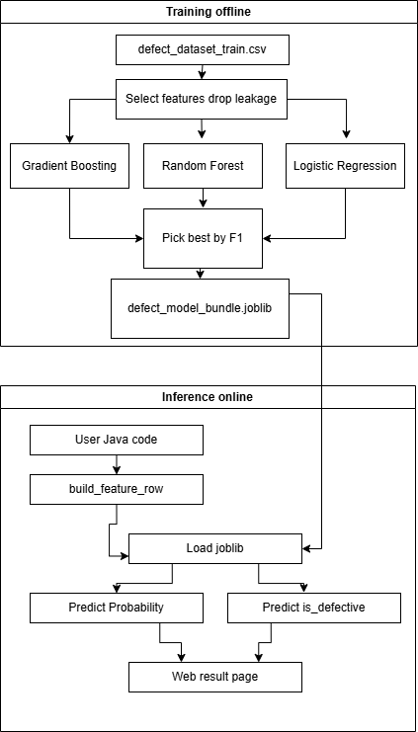
Machine Learning Models
Three machine learning models are compared:
Logistic Regression
Random Forest
Gradient Boosting
The best model is selected using weighted F1-score.
Result :
Best model : Gradient Boosting
Accuracy achieved : approximately 67.15%

Slide 11
Defect Prediction Formula
Defect density is used to classify defect risk.
Defect Density = ( Total Defects / LOC ) * 1000
Density Grades (Based on APSEC 2012 research (DD) ):
Clean ( 0 )
Low ( < 4.3 )
Medium ( 4.3 - 7.47 )
High ( > 7.47 )
Total Defects Include :
Source compile errors
Runtime errors
Test compile errors
Failed tests

Slide 12
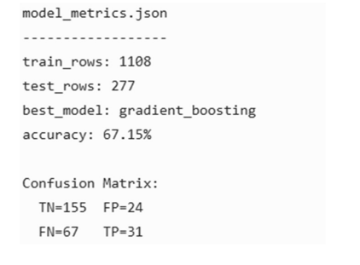
Model Results & Evaluation
Evaluation metrics used :
Accuracy (TP+TN)/(TP+TN+FP+FN)
Precision (TP)/(TP+FP)
Recall (TP)/(TP+FN)
F1-score (Balance between P and R) 2 * (Precision * Recall)/(Precision + Recall)
Confusion Matrix
Dataset Information :
Training rows: 1108
Test rows: 277
Best Accuracy :
67.15% for is_defective target

Slide 13
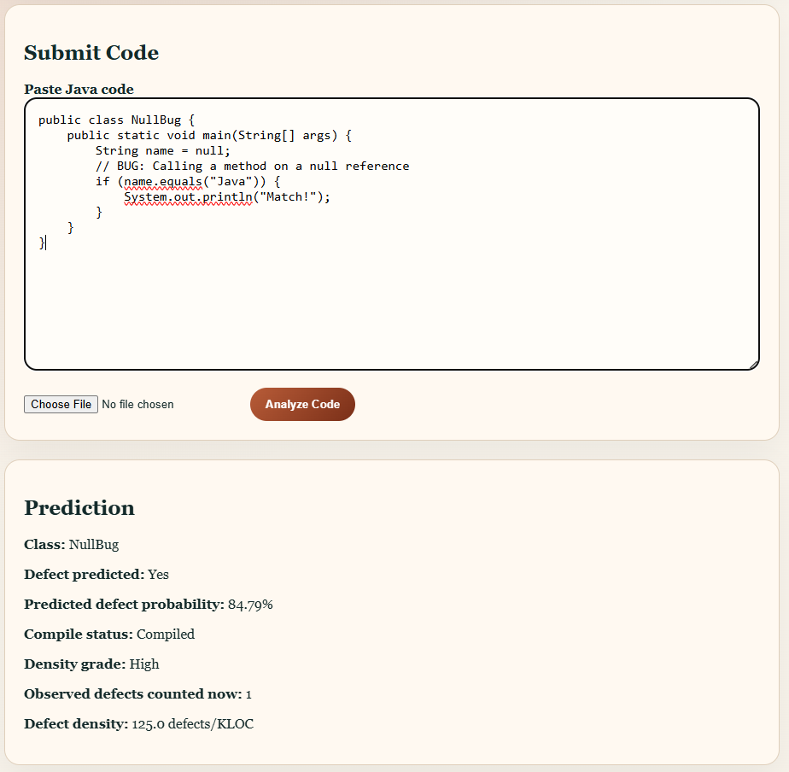
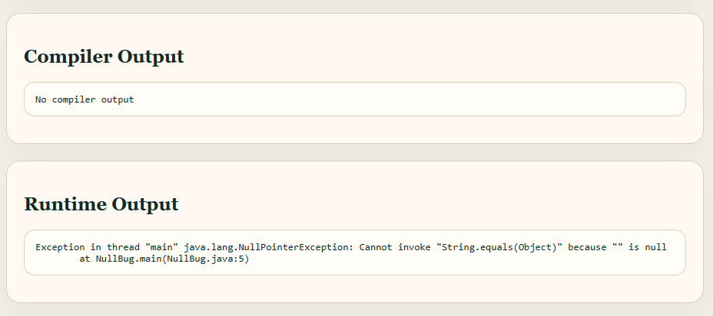
Web Application
The FastAPI web application allows users to :
Paste Java code
Upload .java files
Predict defect probability
View compiler output
View code metrics
View rule-based defect risks
API :
GET / → HTML form
POST /analyze → prediction endpoint

Slide 14
Testing & Debugging
Testing was performed on :
Sample generation
Test generation
Analyzer output
Model metrics
Web interface
Issues Fixed :
Analyzer hanging issue fixed using timeouts
Missing JUnit jar auto-download added
Test compile path issue fixed
Model loading issue fixed
Data leakage removed from training

Slide 15
Advantages of the System
Automated Java defect analysis
Early defect prediction
Generates JUnit tests automatically
Provides web-based prediction
Supports deployment using Docker and Render
Modular pipeline design

Slide 16
Future Work
Future improvements suggested in the report:
Improve defective-class recall
Use AST-based parsing
Support more languages like Python and C++
Run JUnit on uploaded web code in sandbox
Add user login and prediction history
Add SHAP explainability
Add CI plugin for GitHub pull requests

Slide 17
Conclusion
Successfully developed a Java Defect Predictor
Combined ML, static analysis, testing, and web prediction
Created modular and documented pipeline
Demonstrated early defect risk estimation using Java metrics

Slide 18
References :
Ollama – Local LLM runtime. https://ollama.com/
GitHub REST API Documentation. https://docs.github.com/en/rest
Shah, Morisio, Torchiano, An Overview of Software Defect Density, APSEC 2012, DOI: 10.1109/APSEC.2012.93
Render Deployment Docs. https://render.com/docs
T. Hall et al., "A Systematic Literature Review on Fault Prediction Performance in Software Engineering," IEEE TSE, vol. 38, no. 6, pp. 1276-1304, 2012. DOI: 10.1109/TSE.2011.27
T. Menzies et al., "Data Mining Static Code Attributes to Learn Defect Predictors," IEEE TSE, vol. 33, no. 1, pp. 2-13, 2007. DOI: 10.1109/TSE.2007.256655
D. A. Rebro, B. Rossi, and S. Chren, "Source Code Metrics for Software Defects Prediction," Proc. EASE, 2023. DOI: 10.1145/3555776.3577809
F. Lomio, S. Moreschini, and V. Lenarduzzi, "A Machine and Deep Learning Analysis among
Code link : https://github.com/abhi-raj76/SE_MAJOR_PROJECT
Website Link : https://defect-prediction-uoh-project.onrender.com/

Slide 19
Thank You !!!

